Slide 1
© We Teach MFL

Slide 2
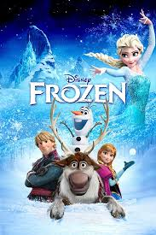
Teacher note: Click on the purple box to reveal a clue
Guess the Film
Can you guess the film based on it’s translation?
Ψυχρά κι Ανάποδα
Cold and Upside Down
This animated film tells the story of two royal sisters in a kingdom cursed by eternal winter, with one having magical ice powers and the other embarking on a daring quest to save her.
Need a clue?
© We Teach MFL

Slide 3
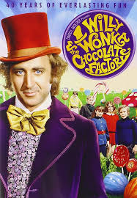
Guess the Film
Can you guess the film based on it’s translation?
Drengen, der druknede i chokoladesovsen
The boy who drowned in chocolate
A poor boy wins a golden ticket to tour a magical chocolate factory run by an eccentric and mysterious candy maker.
Need a clue?
© We Teach MFL

Slide 4
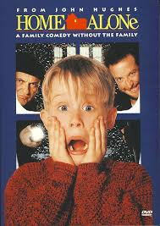
Guess the Film
Can you guess the film based on it’s translation?
Maman, j’ai raté l’avion
Mum, I missed the plane
A young boy is accidentally left behind when his family goes on vacation, and he must defend his house from two bumbling burglars using clever traps.
Need a clue?
© We Teach MFL

Slide 5
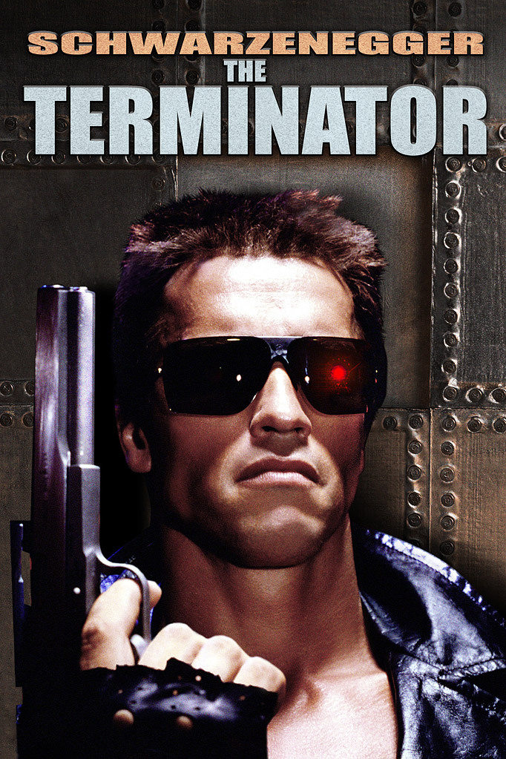
Guess the Film
Can you guess the film based on it’s translation?
O Exterminador Implacável
The Relentless Exterminator
In this sci-fi classic, a cyborg is sent from the future to eliminate the mother of the future leader of the human resistance against machines. Starring Arnold Schwarzenegger.
Need a clue?
© We Teach MFL

Slide 6
Guess the Film
Can you guess the film based on it’s translation?
Aksjon skyscraper
Action Skyscraper
During a Christmas party at a high-rise building, a lone cop must thwart a group of terrorists who have taken hostages and are demanding a ransom. Starring Bruce Willis.
Need a clue?
© We Teach MFL

Slide 7
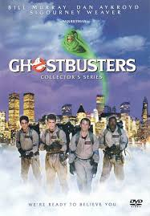
Guess the Film
Can you guess the film based on it’s translation?
Het bovennatuurlijke superspektakel
Supernatural Super Spectacle
A group of scientists in New York City start a paranormal investigation business to deal with a surge of supernatural activity in the city.
Need a clue?
© We Teach MFL

Slide 8
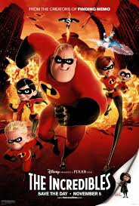
Guess the Film
Can you guess the film based on it’s translation?
Die Unglaublichen
The Unbelievables
A superhero family comes out of retirement to save the world while dealing with the challenges of living undercover and balancing family life.
Need a clue?
© We Teach MFL

Slide 9
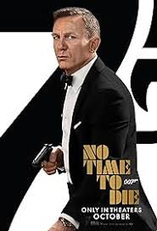
Guess the Film
Can you guess the film based on it’s translation?
Mourir peut attendre
To Die Can Wait
This film marks the latest adventure of a British spy with a license to kill, facing a new villain and navigating his own personal turmoil. Starring Daniel Craig.
Need a clue?
© We Teach MFL

Slide 10
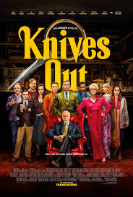
Guess the Film
Can you guess the film based on it’s translation?
Cena con delitto
Dinner with Crime
In this modern whodunit, a renowned mystery novelist is found dead, and a detective must unravel the tangled web of lies within a wealthy family. Starring Daniel Craig.
Need a clue?
© We Teach MFL

Slide 11
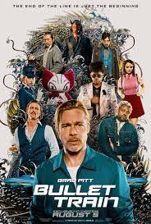
Guess the Film
Can you guess the film based on it’s translation?
Gyilkos járat
Murderous Train
This action-packed film features a high-speed train journey in Japan, where five assassins find themselves on a collision course with fate. Starring Brad Pitt.
Need a clue?
© We Teach MFL

